Slide 1

Puberty
Year 7 Health – 2024
Lesson 8

Slide 2

Today’s focus
Label the male reproductive system.
Define the different parts of the male reproductive system.
Describe the journey of the sperm.
Describe the journey of an ovum.

Slide 3

(pg. 71)
In the first 5 minutes of each lesson, you will complete your revision page, you will find these throughout your booklet.
The revision page consists of three questions. It will need to be completed in detail. One-word answers will not be accepted.
The three questions :
What two concepts or ideas did I learn in class last week?
What did I find interesting about last week’s lesson? Provide a specific example.
Any questions or new words you have learnt?
The teacher will go over this each lesson with you to see what you have learnt. It is a great way for you to revisit content and test your memory.

Slide 4
TRUE OR FALSE?
TRUE = STAND FALSE = SIT
The sun is good for your skin and slows down aging.
Stress can contribute to skin problems.
Perfumes are the same as antiperspirants and help stop body odour developing.
Diet is a major contributing factor for acne.
Body odour starts to increase during puberty.
We only have sweat glands under our arms.
Males tend to produce more sweat than females.
MYTH
FACT
MYTH
MYTH
FACT
MYTH
FACT
Notes:
OPTIONAL ACTIVITY
The sun can aggravate acne and speeds up the process of aging and can cause skin cancer.
Stress doesn’t cause pimples, but it can make them worse.
Perfumes and deodorant mainly help to mask or cover up B.O. Antiperspirants help to stop B.O from developing by reducing underarm wetness.
It is now believed that diet is not a cause of acne. However, for some people it may contribute. A well balanced diet is beneficial for our overall health and well-being.
Specific glands become active during puberty which produce perspiration (sweat), which when mixed with the bacteria on our skin can cause body odour.
Sweat glands are everywhere on our body, except lips and ears. Each person has about 2.5million.
Males tend to produce more sweat than females (on average).

Slide 5
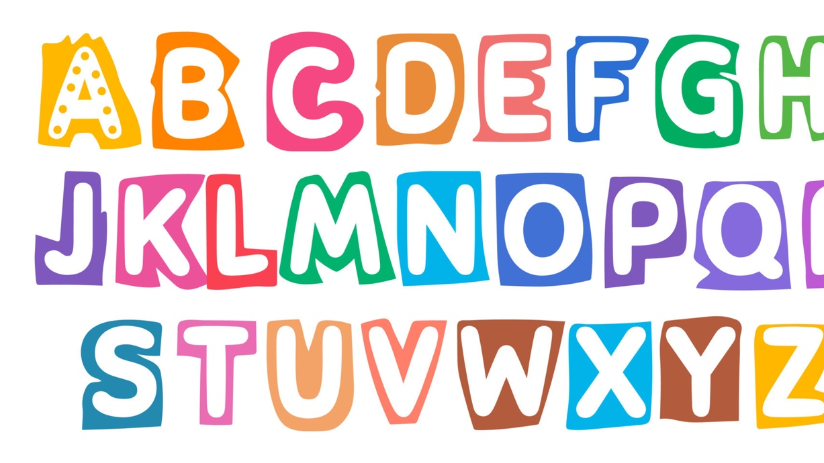
Hook: Alphabet RACE (pg.72)
Individually, complete the Alphabet Race in your workbooks.
Write ONE WORD that relates to the topic of puberty that begins with each letter of the alphabet.
Be prepared to share your answers.
You have 5 minutes.
Notes:
OPTIONAL ACTIVITY
First person who is successful can win a prize/person with the most answers at the end of the time wins a prize.
Topics to think of – labelled parts of the body, different names for things, physical/social/emotional changes
Suggestions: G – gonads
I – individuality
J – jealousy
K – kinky, kids
Q – queer
X – X chromosome
Y – Y chromosome
Z – zest (for life 🤷🏼‍♀️)

Slide 6
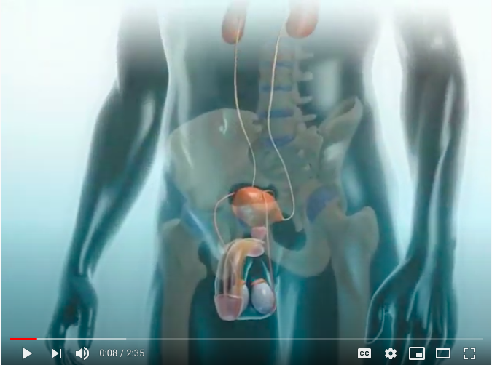
Male reproductive system
https://www.youtube.com/watch?v=nr5W9trSv8I
Notes:
OPTIONAL
Click the link below to watch the video
https://www.youtube.com/watch?v=nr5W9trSv8I

Slide 7
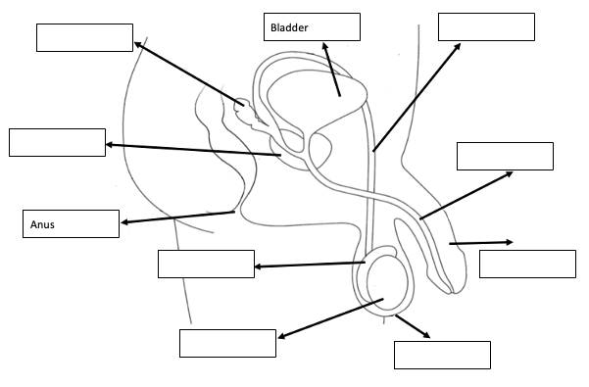
What are the male sex organs? (pg.73)
Reproduction is the process by which organisms make more organisms like themselves. But even though the reproductive system is essential to keeping a species alive, unlike other body systems, it's not essential to keeping an individual alive.
As previously discussed, the whole point of the male and female reproductive systems it to allow us to reproduce and create a baby.
The male reproductive system is made up of different parts.
Like in females, hormones trigger the development of these organs.
The primary male hormone is testosterone.
Notes:
Use the information and definitions over the next slides to help

Slide 8
Activity 1: What are the male sex organs? (pg.73)
Follow along with the information on the following slides to assist you in labelling the male reproductive system.
For the remaining spaces, read through the definitions in your workbook to complete your labelled diagram.
Notes:
RELEVANT TO TEST – this diagram is in their test.
Use the information and definitions over the next slides to help.

Slide 9
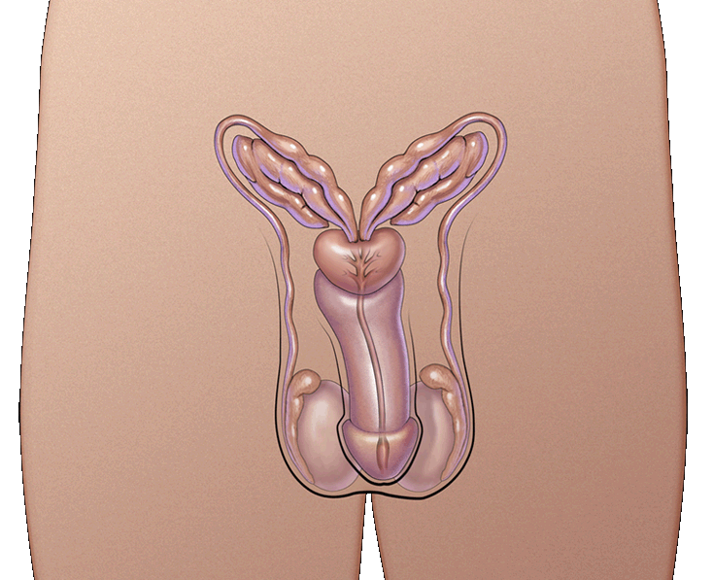
What are the MALE sex organs?
These parts are also called the reproductive organs and genitals
The parts are:
Urethra
Penis
Testicles or Testes
Scrotum
Notes:
RELEVANT TO TEST
Discuss

Slide 10
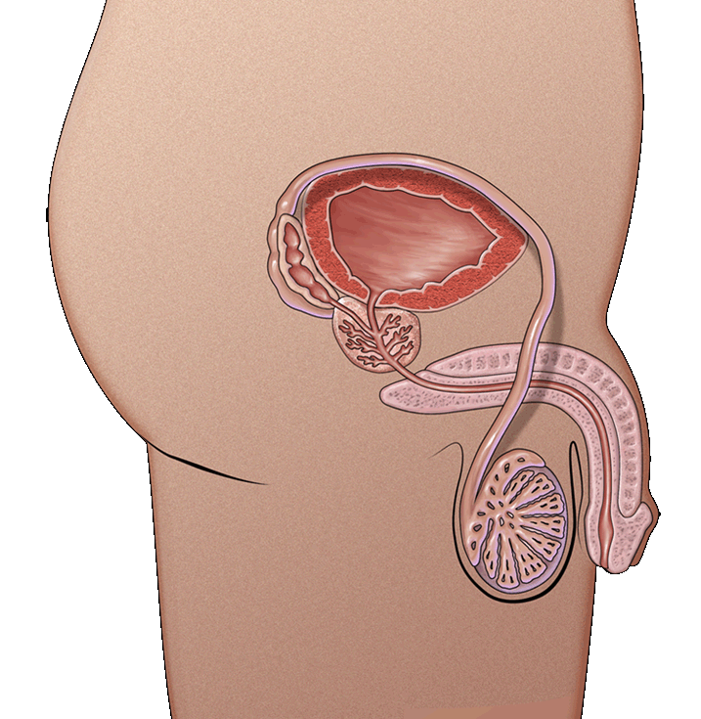
What are the MALE sex organs?
Urethra
the tube through which urine and semen leaves the boy’s body
Penis
tube-like organ that hangs outside the body
come in all sizes and shapes, determined by our genes
Testicles or testes
usually two, one hangs lower
Sometimes called balls or nuts
Where sperm are made
Scrotum
bag of skin that holds testicles
keeps them at right temperature to make sperm, slightly cooler than body’s temperature
gets bigger and baggier and turns a darker colour
Foreskin
Roll of skin covering the end of the penis.
This skin can be removed through the process of circumcision.
Notes:
RELEVANT TO TEST
Discuss (touch on circumcision --> T/F section of test)

Slide 11
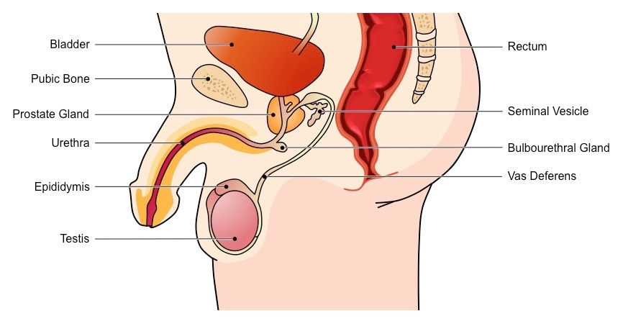
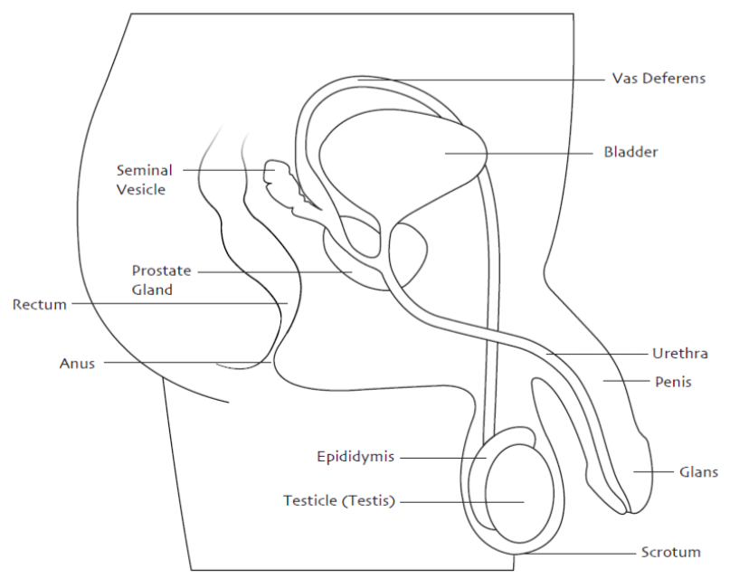
Notes:
Answers

Slide 12
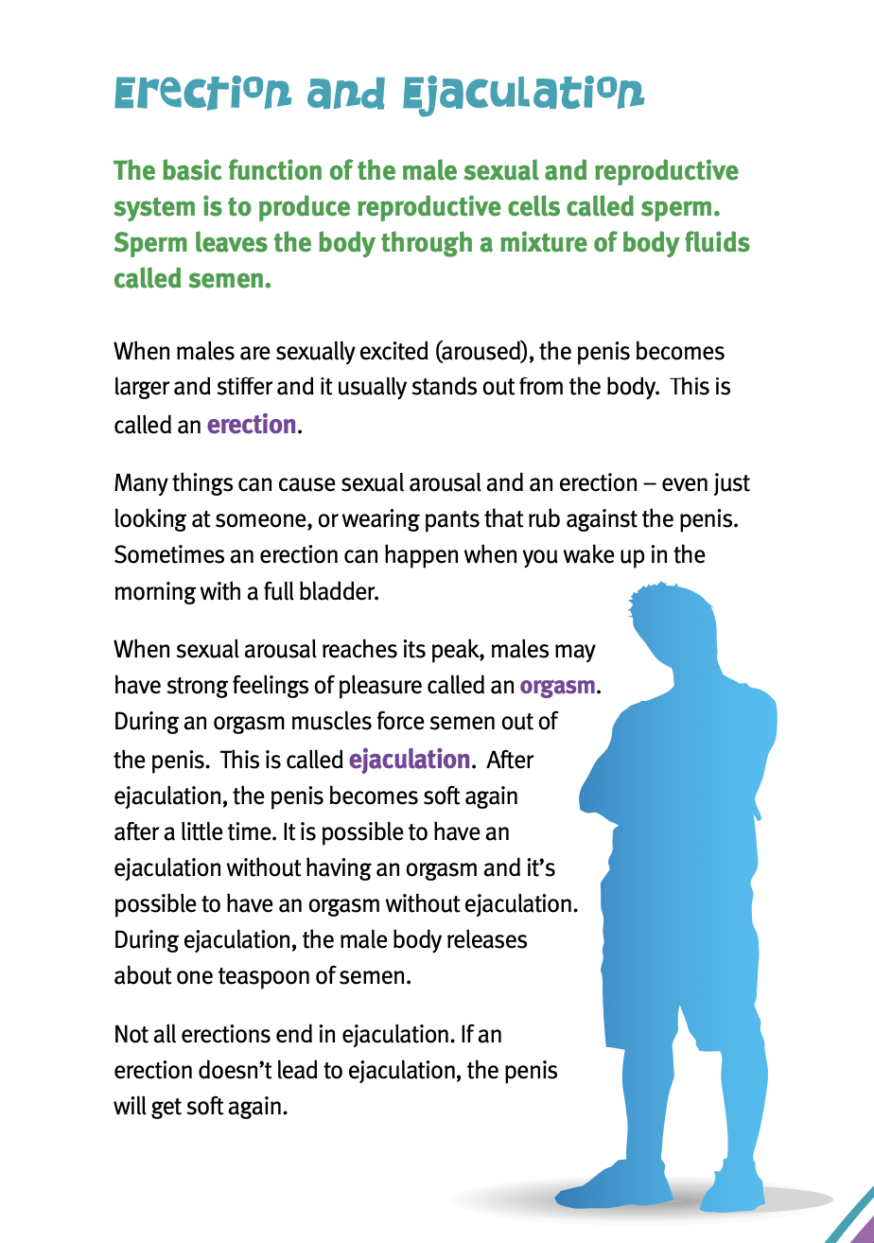
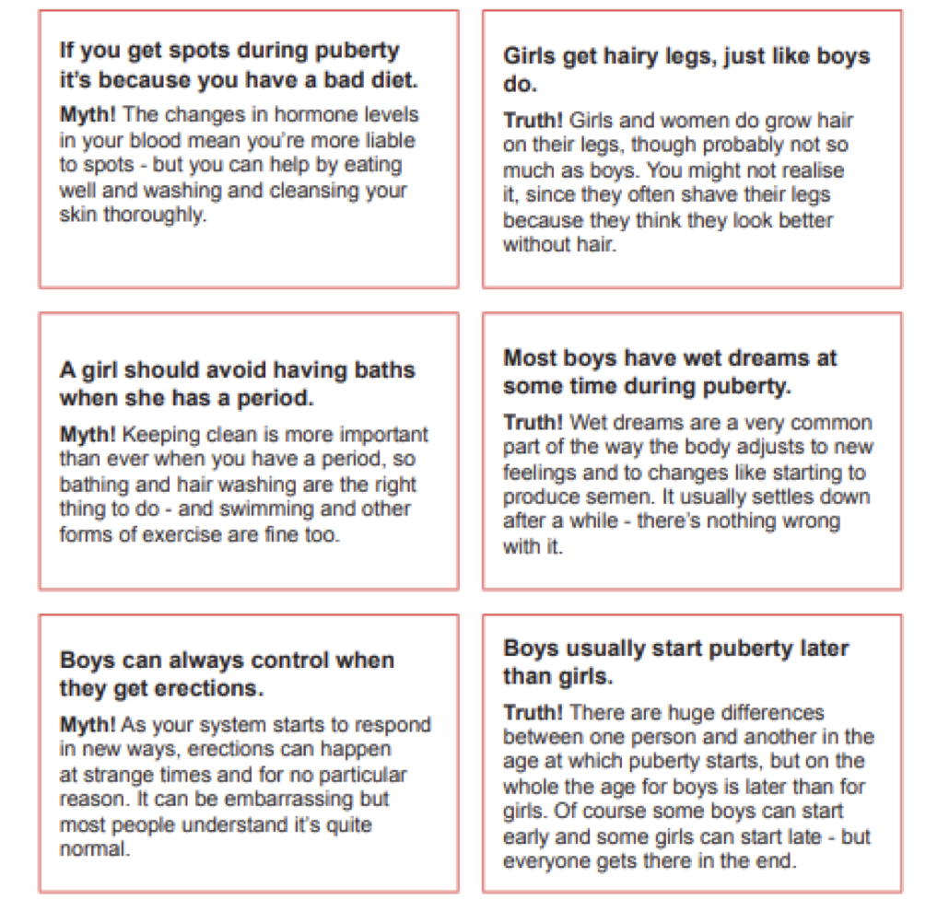
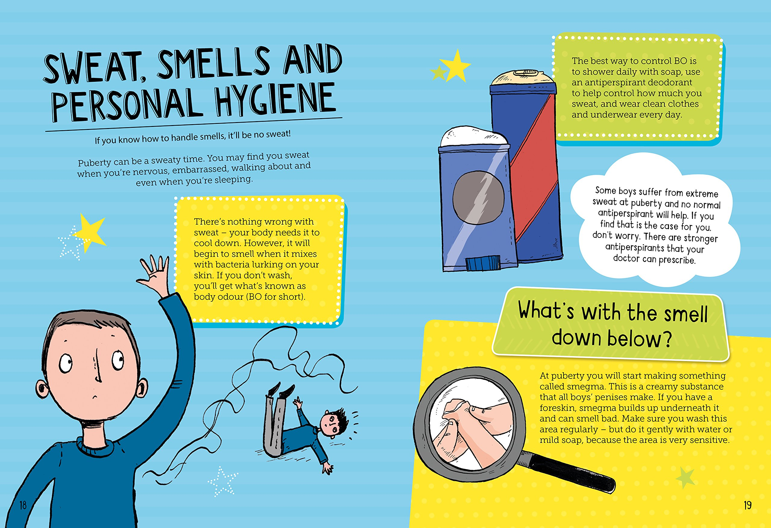
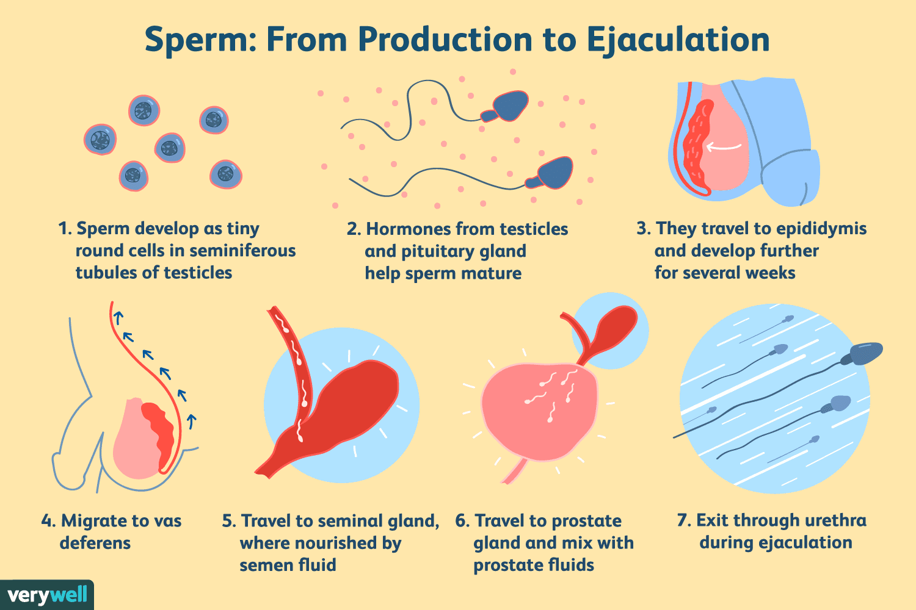
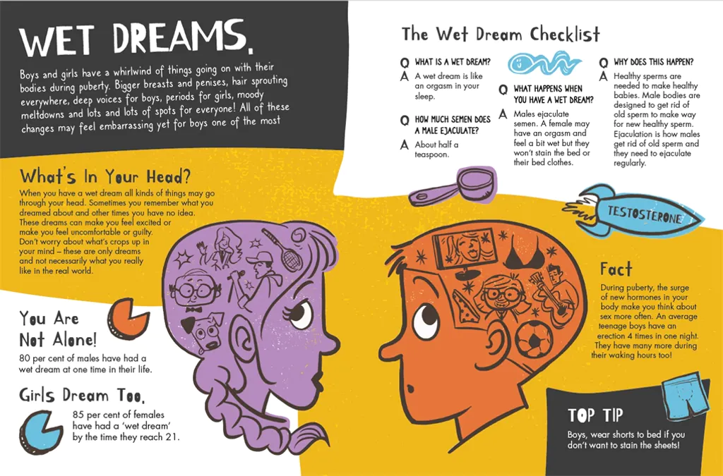
Activity 2: Research Walk – Male Reproductive system (pg.74-75)
Around the room are different posters with information about puberty and the male reproductive system.
Walk around the class and use each poster to help you answer the relevant questions.
You have 20 minutes.
Notes:
Ways to run this activity:
(can change the slide information to suit how you are going to run the class if you want/need to)
Research walk: Place the posters around the room on different walls. Students walk around the room to read the posters and complete their work. Allocate 15-20 minutes to complete the questions and go over answers as a class (these instructions are explained on the slide). Put a timer on the screen.
Pros – allows students to walk around and mingle.
Cons – could be difficult if you have a silly class.
Group work: Have students working in 5 groups. Allow a 4-5 minutes to read the poster and answer the relevant questions. Rotate the posters around the class until each group has seen and used each poster to answer the questions. Put a timer on the screen.
Pros – allows students to mingle with others and work together.
Cons – more stationery for students. Could take longer to complete depending on how much time you allow for each poster.
Individually follow along: Go through the information on the slides and students fill in the work as you go.
Pros – could be completed quicker. Easier if you have a harder class who works better seated.
Cons – means more talking for the teacher and less student directed working.

Slide 14
Notes:
Click to reveal the Myths/Truths.

Slide 16
Males and females can both be sexually aroused, and both can orgasm.
Masturbation is the term used to describe the stimulation of one's own genitals.
For reproduction to be able to occur through sexual intercourse, an erection needs to happen.
Notes:
RELEVANT TO TEST
Discuss.

Slide 17
FUN FACT!
The scientific name for a wet dream is a Nocturnal Emission!
Nocturnal = at nighttime.
Emission = the discharge/release of something.
Notes:
RELEVANT TO TEST
(Nocturnal emission in MC)

Slide 18
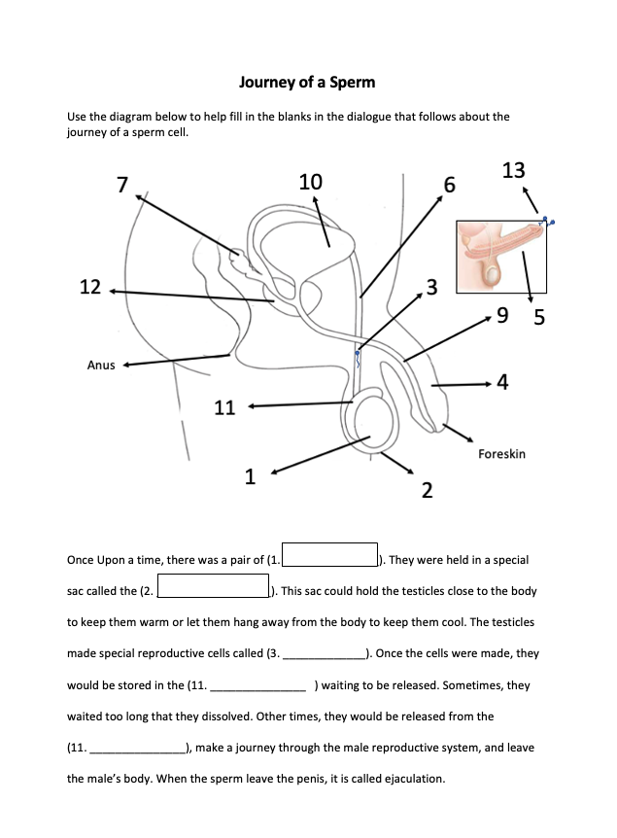
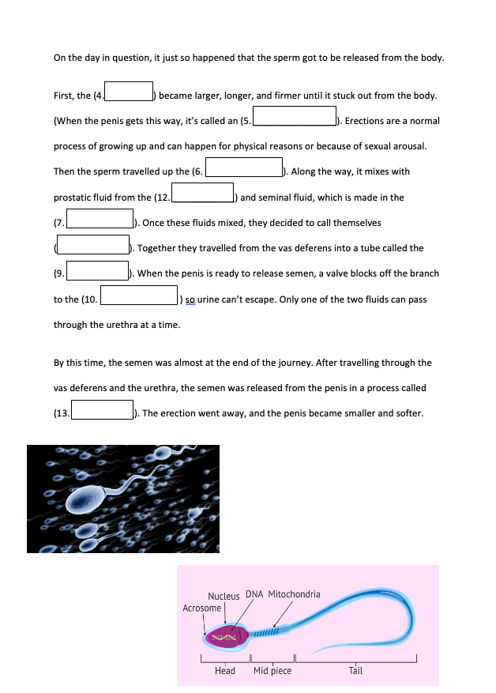
Activity 3: Journey of a Sperm (pg.76-77)
Use your knowledge of the male reproductive system, and the diagram in your books to help you fill in the blanks to uncover the ‘Journey of a Sperm.’
You have 5 minutes to have a read and attempt to fill the blanks on your own, before we discuss the answers.
**Test your recall by not looking at your previous notes.**
Notes:
ALTERNATIVE:
Save time by going through it as a class all together instead of allowing students to have a go on their own.
Or, shorten the time allowed.
Optional to set as homework.

Slide 19
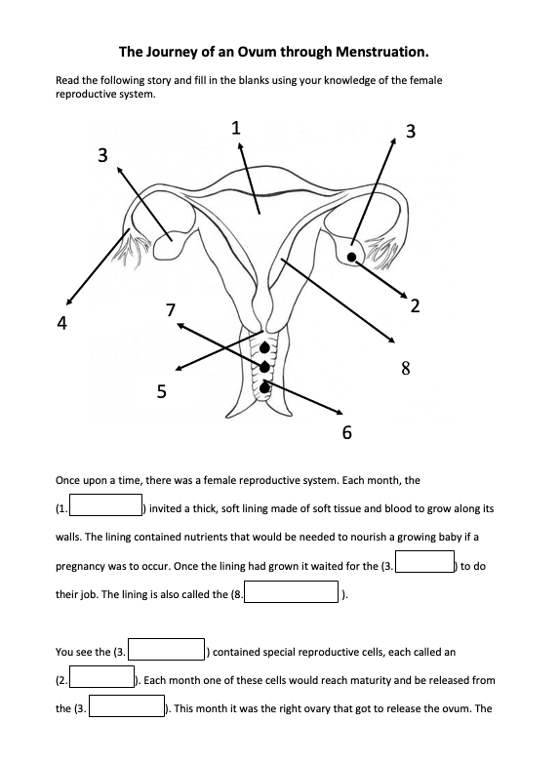
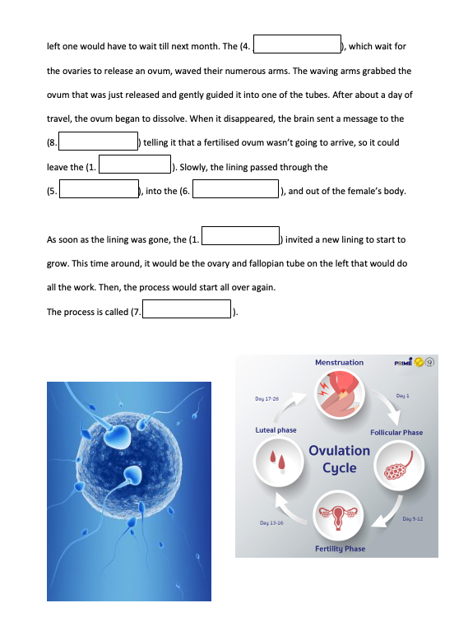
Activity 4: Journey of an OVUM (pg.78-79)
Repeat the previous activity and use your knowledge of the female reproductive system, and the diagram in your books to help you fill in the blanks to uncover the ‘Journey of an Ovum through menstruation.’
You have 5 minutes to have a read and attempt to fill the blanks on your own, before we discuss the answers.
**Test your recall by not looking at your previous notes.**
Notes:
RELEVANT TO TEST
ALTERNATIVE:
Save time by going through it as a class all together instead of allowing students to have a go on their own.
Or, shorten the time allowed.
Optional to set as homework.

Slide 20

GLOSSARY: (Pg. 5)
At the front of your books is your glossary. Turn to your glossary and add the following words and their definitions:
Erection
When a male is sexually aroused, blood rushes to the penis causing it to harden and enlarge.
Sperm
The male sex cell formed in the testes and contains the male DNA.
Ejaculation
The act of ejecting semen from the body.
Notes:
RELEVANT TO TEST

Slide 21
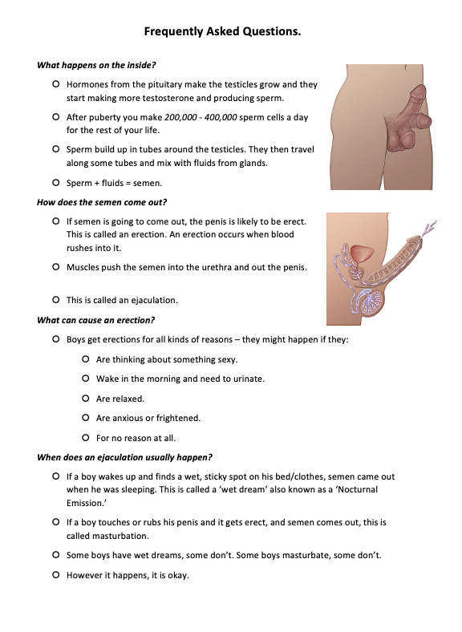
FAQ’s
On page 80 you can find some extra questions and answers related to the male reproductive system.
Notes:
Students can peruse this in their own time, just make them aware of it.

Slide 22
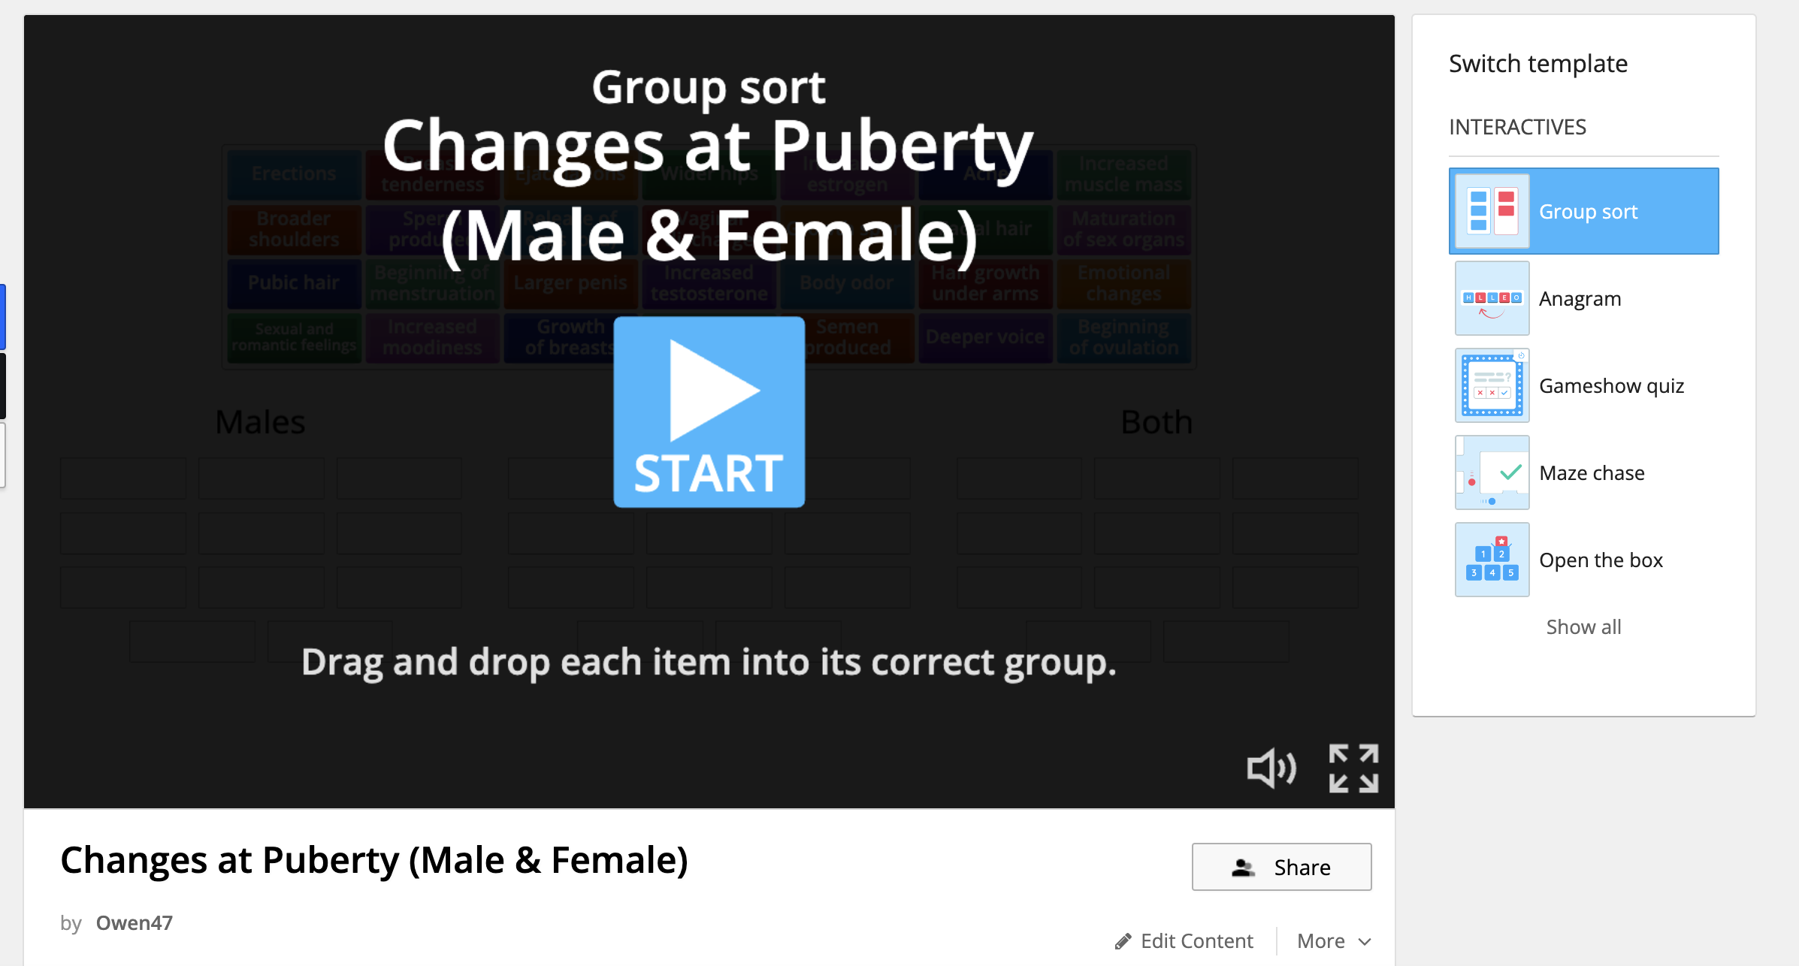
Activity 5: REFLECTION Test your knowledge… (pg.79)
Visit: https://wordwall.net/resource/31937101/changes-at-puberty-male-female
Complete the activity to sort the changes that happen to males and females during puberty.
You have 5 minutes to have a go at these activities.
Notes:
OPTIONAL
Link is also in their books to click on pg______
https://wordwall.net/resource/31937101/changes-at-puberty-male-female

